Slide 1
Few Topics required for existing project
Model In Loop
MAAB guidelines
Coverage Analysis (If Input provided complete model simulation should give complete output of the Model)
Extracting Mat file for Model testing
Software In loop
PolyPhase , RTRT

Slide 2
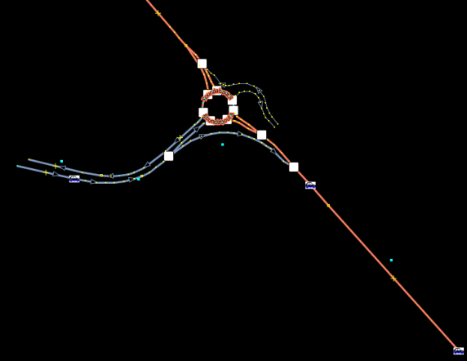
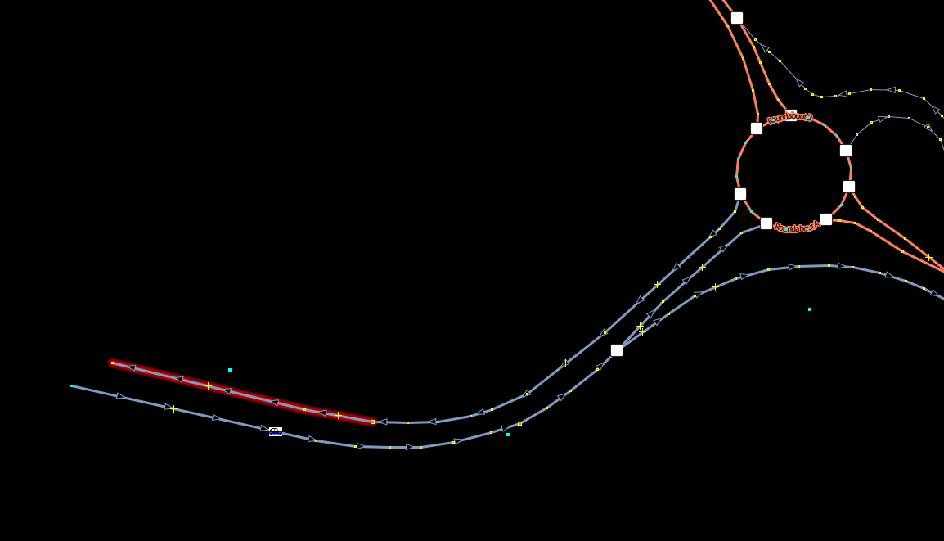
Map In JOSM data
Event Sign = Signals beside the road
Main map file
Ways Which contains group of nodes

Slide 3
Work Flow using m script
Phase 1--
We are importing the OSM data to Matlab (where variables will be stored in structure cells and arrays)
Utilizing the node matrix data the plot is created
Post processing the node matrix we are creating similar road structure
Creation of the route matrix where vehicle has to be travelled to complete the vehicle trace .
Utilizing the route Matrix X co-ordinate we are moving the vehicle using the small distances
We have created the class for the vehicle
Phase 2—
* Utilizing the event signals the functionality of the event sign has to be projected on the road at perpendicular point.
* Creation of list of sign points and utilizing the required sign points .
Vehicle should respond for that specific event when it reaches at that point (which is possible using route matrix).
Phase 3—
creation of Model utilizing the function files generated in phase 1 and Phase 2
Stateflow , simulink
Phase 4
Creation of test vector where the variables data will be feed through the XLs or Mat file to the model , to validate the functionality of the model(MIL)

Slide 4
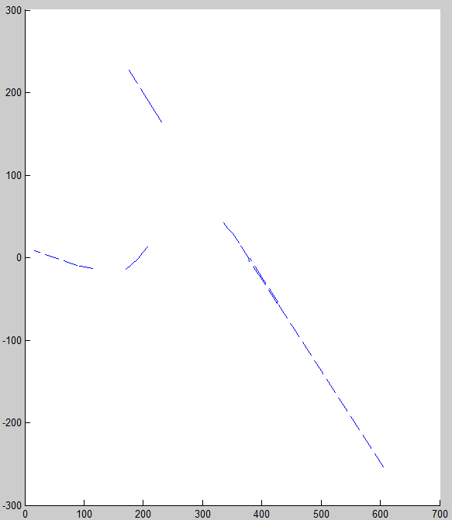
Plot file after parsing the XML data to Matlab using the script
OSM data plot of Route in single line

Slide 5
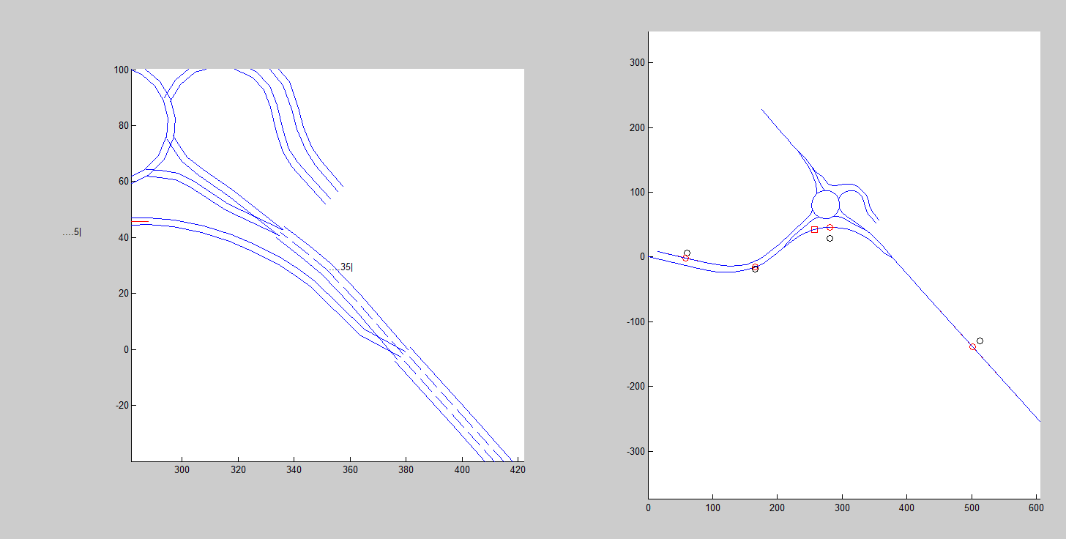
Road model creation using the single line
Sign Point Beside the Road
Vehicle Movement (2 Vehicle)
Sign Point Projected on the road .

